Slide 1
CSE 3105 Software Engineering

Slide 2
Melding the Product and the Process
Customer communication—tasks required to establish effective requirements elicitation between developer and customer.
Planning—tasks required to define resources, timelines, and other project- related information.
Risk analysis—tasks required to assess both technical and management risks.
Engineering—tasks required to build one or more representations of the application.
Construction and release—tasks required to construct, test, install, and pro- vide user support (e.g., documentation and training).
Customer evaluation—tasks required to obtain customer feedback based on evaluation of the software representations created during the engineering activity and implemented during the construction activity.

Slide 3
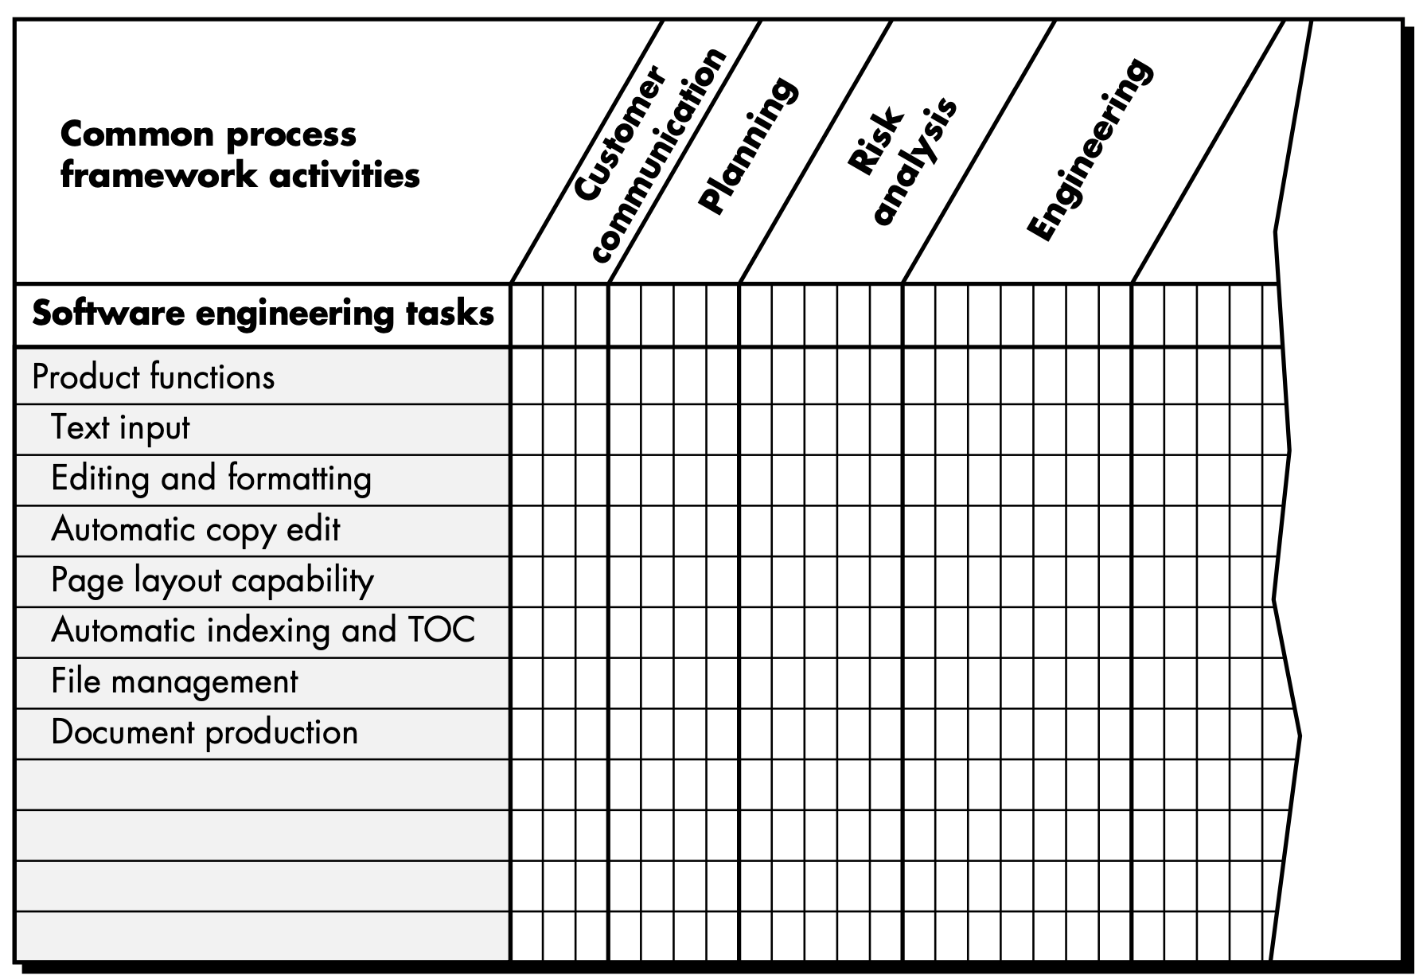

Slide 4
The Project
John Reel [REE99] defines ten signs that indicate that an information systems project is in jeopardy:
Software people don’t understand their customer’s needs.
The product scope is poorly defined.
Changes are managed poorly.
The chosen technology changes.
Business needs change [or are ill-defined].
Deadlines are unrealistic.

Slide 5
Users are resistant.
Sponsorship is lost [or was never properly obtained].
The project team lacks people with appropriate skills.
Managers [and practitioners] avoid best practices and lessons learned.

Slide 6
The Project
Reel [REE99] suggests a five-part commonsense approach to software projects:
Start on the right foot. This is accomplished by working hard (very hard) to understand the problem that is to be solved and then setting realistic objects and expectations for everyone who will be involved in the project. It is reinforced by building the right team (Section 3.2.3) and giving the team the autonomy, authority, and technology needed to do the job.
Maintain momentum. Many projects get off to a good start and then slowly disintegrate. To maintain momentum, the project manager must provide incentives to keep turnover of personnel to an absolute minimum, the team should emphasize quality in every task it performs, and senior management should do everything possible to stay out of the team’s way.

Slide 7
Track progress. For a software project, progress is tracked as work products (e.g., specifications, source code, sets of test cases) are produced and approved (using formal technical reviews) as part of a quality assurance activity. In addition, software process and project measures (Chapter 4) can be collected and used to assess progress against averages developed for the software development organization.
Make smart decisions. In essence, the decisions of the project manager and the software team should be to “keep it simple.” Whenever possible, decide to use commercial off-the-shelf software or existing software components, decide to avoid custom interfaces when standard approaches are available, decide to identify and then avoid obvious risks, and decide to allocate more time than you think is needed to complex or risky tasks (you’ll need every minute).
Conduct a post-mortem analysis. Establish a consistent mechanism for extracting lessons learned for each project. Evaluate the planned and actual schedules, collect and analyze software project metrics, get feedback from team members and customers, and record findings in written form.

Slide 8
W5HH Principle
Why is the system being developed?
What will be done, by when?
Who is responsible for a function?
Where are they organizationally located?
How will the job be done technically and managerially?
How much of each resource is needed?

